Slide 1
Customer Analytics – Customer Lifetime Valuation Modeling

Slide 2

What is “Customer Value”?
Customer-centric approach is the new norm in today’s market – reason being the ample choices people have when choosing a product/service
Some customers create more value for the business by being a loyal customer and some are just one-time buyers
Identifying such groups of customers and targeting only the high-value customers will help the business to at least sustain in this competitive market
Notes:
Image Link: https://www.vecteezy.com/vector-art/477470-people-inside-bank-office-design-concept
Notes:
The world of business has completely changed and revolves around its customers more than ever. The customer-centric approach is the new norm in today’s market. The reason for that is the ample choices people have when choosing a product/service.
In this era of businesses fighting against each other to better serve and seize customers from their competitors, the need for them to grow and retain their existing customer base is very important.
But similar to the process of acquiring customers, there is a huge cost associated with the process of retaining existing customers too. (by giving discounts, targeted offers, etc.)
So, you might think, do they need to retain every single customer? Well, not really. In every business, some customers create more value for the business by being a loyal customer and some are just one-time buyers. Identifying such groups of customers and targeting only the high-value customers will help the business to at least sustain in this competitive market.
Now, the real challenge begins — How to find the customer value? Before answering this question, let’s just define what does “customer value” means.

Slide 3

Customer Lifetime Value
To ensure continuous revenue, organizations need to identify those top or high-value customers and maintain effective relationships with them
Targeting a new customer is more costly than retaining existing customers because you don’t need to spend resources, time, and work hard to acquire new customers
Business analysts accurately calculate customer acquisition cost using Customer Lifetime Value
Notes:
Image Link: https://www.vecteezy.com/vector-art/160573-referral-business-people-vector-flat-illustration
Notes:
Italian economist Vilfredo Pareto states that 80% of the effect comes from 20% of the causes, this is known as 80/20 rule or Pareto principle. Similarly, 80% of companies business comes from 20% customers. Companies need to identify those top customers and maintain the relationship with them to ensure continuous revenue. In order to maintain a long-term relationship with customers, companies need to schedule loyalty schemes such as the discount, offers, coupons, bonus point, and gifts.
Targeting a new customer is more costly than retaining existing customers because you don’t need to spend resources, time, and work hard to acquire new customers. You just have to keep the existing customers happy. Business analyst's accurately calculate customer acquisition cost using CLTV(Customer Lifetime Value).

Slide 4
Customer Lifetime Value
Customer value or Customer Lifetime Value (CLV) – is the total monetary value that represents the amount of revenue or profit a customer will give the bank over the period of the relationship
CLV helps answer the following questions:
How to Identify the most profitable customers?
How can a company offer the best product and make the most money?
How to segment profitable customers?
How much budget need to spend to acquire customers?
Notes:
Image Link:
Notes:
Customer Lifetime Value is a monetary value that represents the amount of revenue or profit a customer will give the company over the period of the relationship. CLTV demonstrates the implications of acquiring long-term customers compare to short-term customers. Customer lifetime value (CLV) can help you to answers the most important questions about sales to every company:
How to Identify the most profitable customers?
How can a company offer the best product and make the most money?
How to segment profitable customers?
How much budget need to spend to acquire customers?

Slide 5

Customer Lifetime Value
Using CLV as a metric can help provide an upper limit to customer acquisition costs while also helping to know which types of customers are worth pursuing for long-term value and which ones are likely to switch banks solely for lower prices
This in turn, helps you make better-informed decisions when it comes to marketing, sales and pricing for new customers and guide your front-line employees so that they invest their time and resources appropriately – and maximize your customer lifetime value
Notes:
Image Link: https://www.vecteezy.com/vector-art/664350-businessman-catching-money-with-fishing-rod
Notes:
Customer lifetime value (or CLV) is the worth of a customer over the length of their entire tenure at your bank and is a much more complex calculation than just net profit or Total Sales. Using customer lifetime value as a metric requires your entire bank to shift its focus from quarterly profits to the long-term health of customer relationships. Not only does CLV help you track your customer profitability, but it also provides an upper limit on your customer acquisition costs. Thus, a thorough customer lifetime value analysis helps you make better-informed decisions when it comes to marketing, sales and pricing for new customers. While using other metrics (like maximizing product value or curbing transactional costs) might be valuable to your marketing analysis, these metrics are only a distraction for your front-line employees. Instead, your retail banking staff needs to know which types of customers are worth pursuing for long-term value and which ones are likely to switch banks solely for lower prices. Understanding the difference between those two types of customers guides your front-line employees so that they invest their time and resources appropriately – and maximize your customer lifetime value.

Slide 6
Python Case Study – Customer Lifetime Valuation Modeling
Objective:
Predict the lifetime valuation of a customer to facilitate target marketing.
Dataset:
https://www.kaggle.com/saniyajaswani/credit-card-data
The dataset delineates the demographics and policy specifics purchased by the customers from a bank/firm. Customer Lifetime Valuation is the target variable that is predicted

Slide 7
Python Case Study – Customer Lifetime Valuation Modeling
Data Preprocessing:
Feature standardization – wherein different levels of similar nature in a categorical feature are grouped into one level
Feature Scaling – scaling numerical features to reduce variance
EDA – exploratory analysis of features and target variable using boxplots, distplot and heatmap.
Outlier detection and treatment – the extreme values present throughout the data called outliers are identified and removed
Create dummies – binary columns to indicate the presence and absence of a specific information, encoded as ‘1’ and ‘0’ respectively

Slide 8
Python Case Study – Customer Lifetime Valuation Modeling
Machine Learning algorithms:
Split the data into training data (to fit the model) and test data (to validate the model)
Since we are predicting the lifetime value of customers, this is a Regression problem
We fit the following models with the training data – Linear Regression, Decision Tree Regressor, Random Forest Regressor, Gradient Boost and Adaptive Boost

Slide 9
Random Forest Regressor
Random forest is a supervised learning algorithm
The "forest" it builds, is an ensemble of decision trees, usually trained with the “bagging” method. The general idea of the bagging method is that a combination of learning models increases the overall result
Random forest adds additional randomness to the model, while growing the trees. Instead of searching for the most important feature while splitting a node, it searches for the best feature among a random subset of features
This results in a wide diversity that generally results in a better model
Random forest prevents Overfitting by creating random subsets of the features and building smaller trees using those subsets

Slide 10
AdaBoost Regressor
Boosting is an ensemble technique that attempts to create a strong classifier from a number of weak classifiers
This is done by building a model from the training data, then creating a second model that attempts to correct the errors from the first model.
Models are added until the training set is predicted perfectly or a maximum number of models are added
AdaBoost is best used to boost the performance of decision trees on binary classification problems
AdaBoost was designed in such a way that at every step the sample distribution was adapted to put more weight on misclassified samples and less weight on correctly classified samples. The final prediction is a weighted average of all the weak learners, where more weight is placed on stronger learners

Slide 11
GradientBoosting Regressor
Gradient boosting algorithm builds first weak learner and calculates the Loss Function. It then builds a second learner to predict the loss after the first step. The step continues for third learner and then for fourth learner and so on until a certain threshold is reached
Gradient boosting increases the accuracy by minimizing the Loss Function (error which is difference of actual and predicted value) and having this loss as target for the next iteration
The main difference therefore is that Gradient Boosting is a generic algorithm to find approximate solutions to the additive modeling problem, while AdaBoost can be seen as a special case with a particular loss function (Exponential loss function). Hence, gradient boosting is much more flexible

Slide 12
Python Case Study – Customer Lifetime Valuation Modeling
Evaluation of models:
Evaluate model performance with the help of Mean Squared Error, Root Mean Squared Error, Mean Absolute Error, R-squared value and Adjusted R-squared value
Compare all models and finalize on the model with the best metrics
The model with least MSE, RMSE & MAE and the highest R-squared & Adjusted R-squared values is chosen as the best one
Determine feature importance score with the selected best performing model and visualize the same to analyse features pivotal in customer lifetime value prediction

Slide 13
Python Case Study – Customer Lifetime Valuation Modeling
Post-modelling analysis and business takeaways:
A summation of CLV predictions of all customers results in a valuation of the total customer base, which can be important for firm valuation purposes
Customers who opted for 'Extended' & 'Premium' policy coverage offer more future value since their choice of policy plan imply more profit for the bank/firm. By understanding these customers’ behavioural patterns and their preferences, the bank will be able to align their strategy to match the customers’ needs and focus insurance cost and staff resources accordingly. This information will also help to anticipate and address customers’ desires and in turn display the bank’s commitment to placing customers’ needs as a priority. It’ll also assist in minimizing the risk of losing them to competitors who may be ready to offer them competitive and customized offers.

Slide 14
Python Case Study – Customer Lifetime Valuation Modeling
‘Number of Policies’ and ‘Monthly Premium Auto’ are the top significant features that are vital in CLV prediction which is also intuitive in a way - since customers with more insurance policies who pay their monthly premium for all those policies/plans are more likely to generate value for the firm rather than those with less number of policies
Employed customers generate more revenue and business for banks than any other for such people are more likely to pay off their credit card bills or loans on time. A good strategy to strengthen the relationship with these customers can go a long way in terms of generating revenue
Income is always a great indicator with regards to CLV as higher the income, higher the value generation

Slide 15
Python Case Study – Customer Lifetime Valuation Modeling
Understanding factors that help develop a strong CLV model can help guide the bank to invest in specific customer segments and to shift money to target the segments with the highest potential value -- all while keeping the current customers loyal to the bank
It’s hard to target each customer. If we have access to customer demographics data, we can first create customer segmentation and then predict the CLV value for each segment. This segment level information can then be used for personalized targeting, while also maintaining customer retention

Slide 16
SHAP – creating the SHAP explainer
Install SHAP in ANACONDA – pip install shap
Import the following package:
Load JS visualization in order to visualize the SHAP plots:

Slide 17
SHAP – creating the SHAP explainer
Create the SHAP explainer using the Random Forest model:
The TreeExplainer from the SHAP library is optimized to trace through the Random Forest to find the Shapley value estimates of the features
Extract the Shapley value estimates from test data:

Slide 18
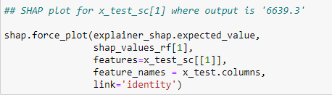
SHAP – creating the SHAP explainer
SHAP plots take in the Shapley value, the test data, test feature names for a specific observation
Plot out the summary plot of all the Shapley values of all the observations for all the features of the test data:

Slide 19
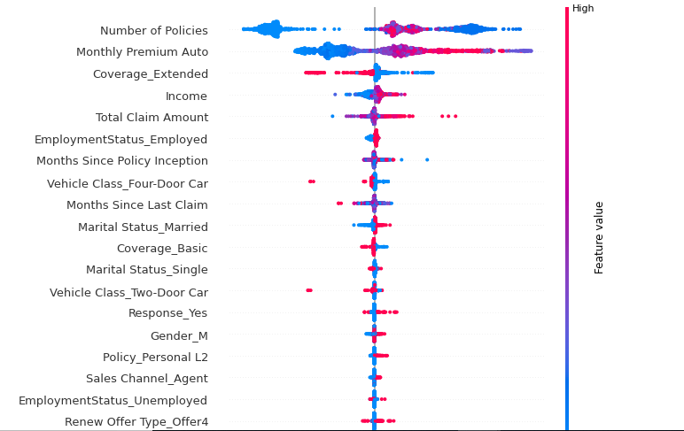
SHAP values – summary plot
SHAP summary plot combines feature importance with its effects on the predictions
Each point is a Shapley value for that instance
Colour represents value of that feature
Features are ordered according to their importance
X-axis = Shapley values
Y-axis = features

Slide 20
SHAP values – summary plot
High values of 'Monthly Premium Auto' & 'Number of Policies' have high and positive impact on the customer lifetime value. The “high” value is indicated by the red color, and the “positive” impact is shown on the X-axis. Similarly, we can infer that high value of 'Coverage_Extended' is negatively correlated with the target variable.

Slide 21
Thank You!

